Slide 1
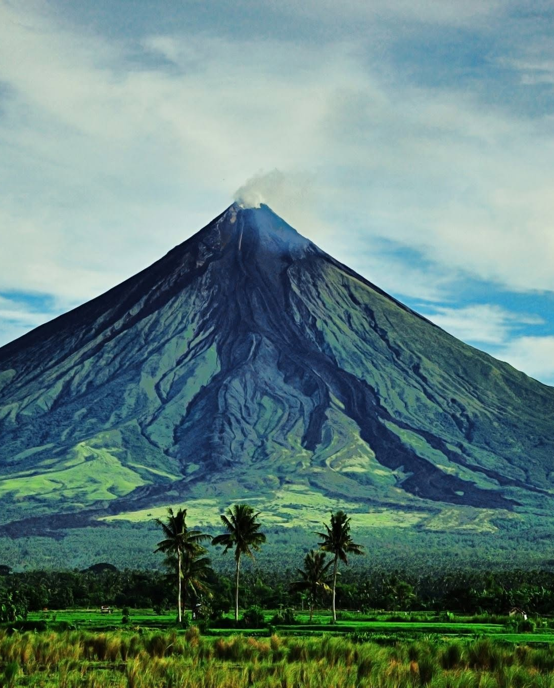
MAYON VIRTUAL FIELD TRIP
A 45-minute classroom launch
An evidence-led exploration of a living stratovolcano, its people, and the limits of a model.
Free educational demonstration - not a live warning or evacuation tool
Notes:
[Sources]
Site asset: Mayon reference image. Teaching framing: https://mayonrajan.com/methods/

Slide 2
MAYON
START WITH A QUESTION
02
What can a landscape tell us about a volcano?
Today we will separate what we can observe from what we infer - then ask what evidence would strengthen an interpretation.
Observe
Interpret
Cone shape, ridges, rivers, settlements, and scale.
Processes, past events, and underground structures.
Notes:
[Sources]
Sources: https://mayonrajan.com/methods/ ; https://volcano.si.edu/volcano.cfm?vn=273030

Slide 3
MAYON
CLASS LAUNCH
03
Open the class view. Let students look first.
mayonrajan.com/?story=1
Ask learners to record one feature they can see directly and one process they think the feature suggests.
Teacher move: do not correct immediately. Ask: “What would count as evidence?”
Notes:
[Sources]
Sources: https://mayonrajan.com/teachers/ ; https://mayonrajan.com/learn/virtual-field-trip/

Slide 4
MAYON
STORY STOP 1
04
The cone is built in layers.
Repeated eruptions add lava and ash around a persistent summit vent. The model makes that long process visible at true scale.
LOOK
ASK
WRITE
Summit, slopes, and ravines
What would repeated deposits leave behind?
One observation + one inference
Notes:
[Sources]
Sources: https://volcano.si.edu/volcano.cfm?vn=273030 ; https://mayonrajan.com/methods/

Slide 5
MAYON
STORY STOPS 2-4
05
History, process, and place all matter.
1814 · Cagsawa
2018 · south flank
Daraga · long view
Separate surviving evidence, historical accounts, and reconstruction.
Discuss vent position, slope, topography, and what is simplified.
Consider heritage, livelihood, memory, and uncertainty.
Notes:
[Sources]
Sources: https://mayonrajan.com/learn/mayon-1814-cagsawa/ ; https://mayonrajan.com/learn/mayon-2018-eruption/

Slide 6
MAYON
HAZARD LITERACY
06
A scenario is not a forecast.
Use the hazard controls to compare processes. Never treat the overlays as an alert, a route prediction, or evacuation advice.
PDC / uson
terrain + eruption conditions
Lava
vent + slope + topography
Lahar
rainfall + loose debris + channels
Ash
wind + changing eruption conditions
Notes:
[Sources]
Sources: https://volcanohazardmaps.org/map/?id=1047 ; https://mayonrajan.com/learn/mayon-hazards-explained/

Slide 7
MAYON
EXIT TICKET
07
Make a claim - then show your evidence.
“A visually persuasive volcano model is a reliable real-time hazard map.”
Agree, disagree, or qualify the claim. Use one observation, one inference, and one source you would check before acting.
The strongest answer draws a clear line between learning and public safety.
Notes:
[Sources]
Sources: https://mayonrajan.com/methods/ ; https://www.usgs.gov/volcano

Slide 8
MAYON
NEXT STEP
08
Keep the field trip open.
Download the printable guide, share the class link, and use the source registry whenever a student asks “how do we know?”
mayonrajan.com/teachers/
Educational visualization only. For current activity and instructions, follow PHIVOLCS and local authorities.
Notes:
[Sources]
Sources: https://mayonrajan.com/teachers/ ; https://mayonrajan.com/methods/

